Slide 1
CS544 Final Project Data Analysis
Yixiong Zhang

Slide 2
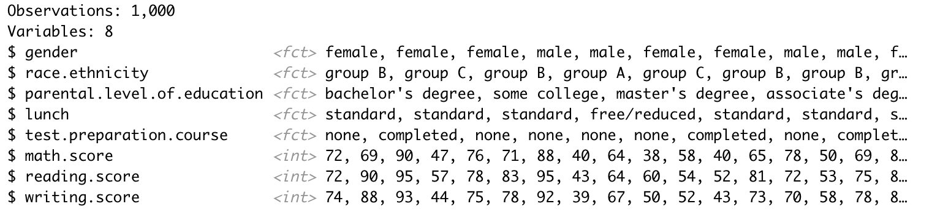
Dataset selection
Select the dataset of Students Performance in Exams from https://www.kaggle.com/datasets
Dataset variables include:
gender
race/ethnicity
parental level of education
lunch
test preparation course
math score
reading score
writing score

Slide 3
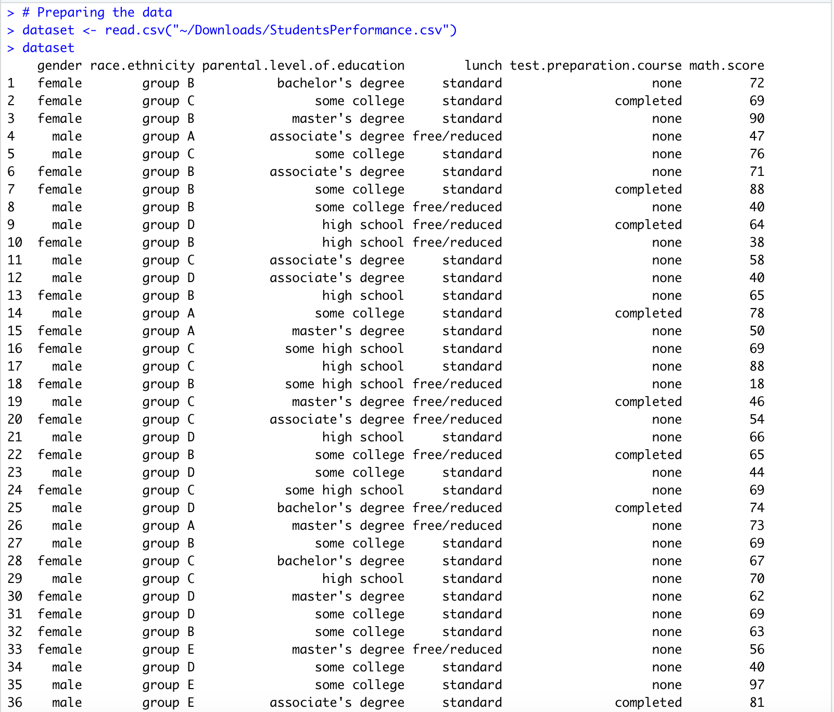
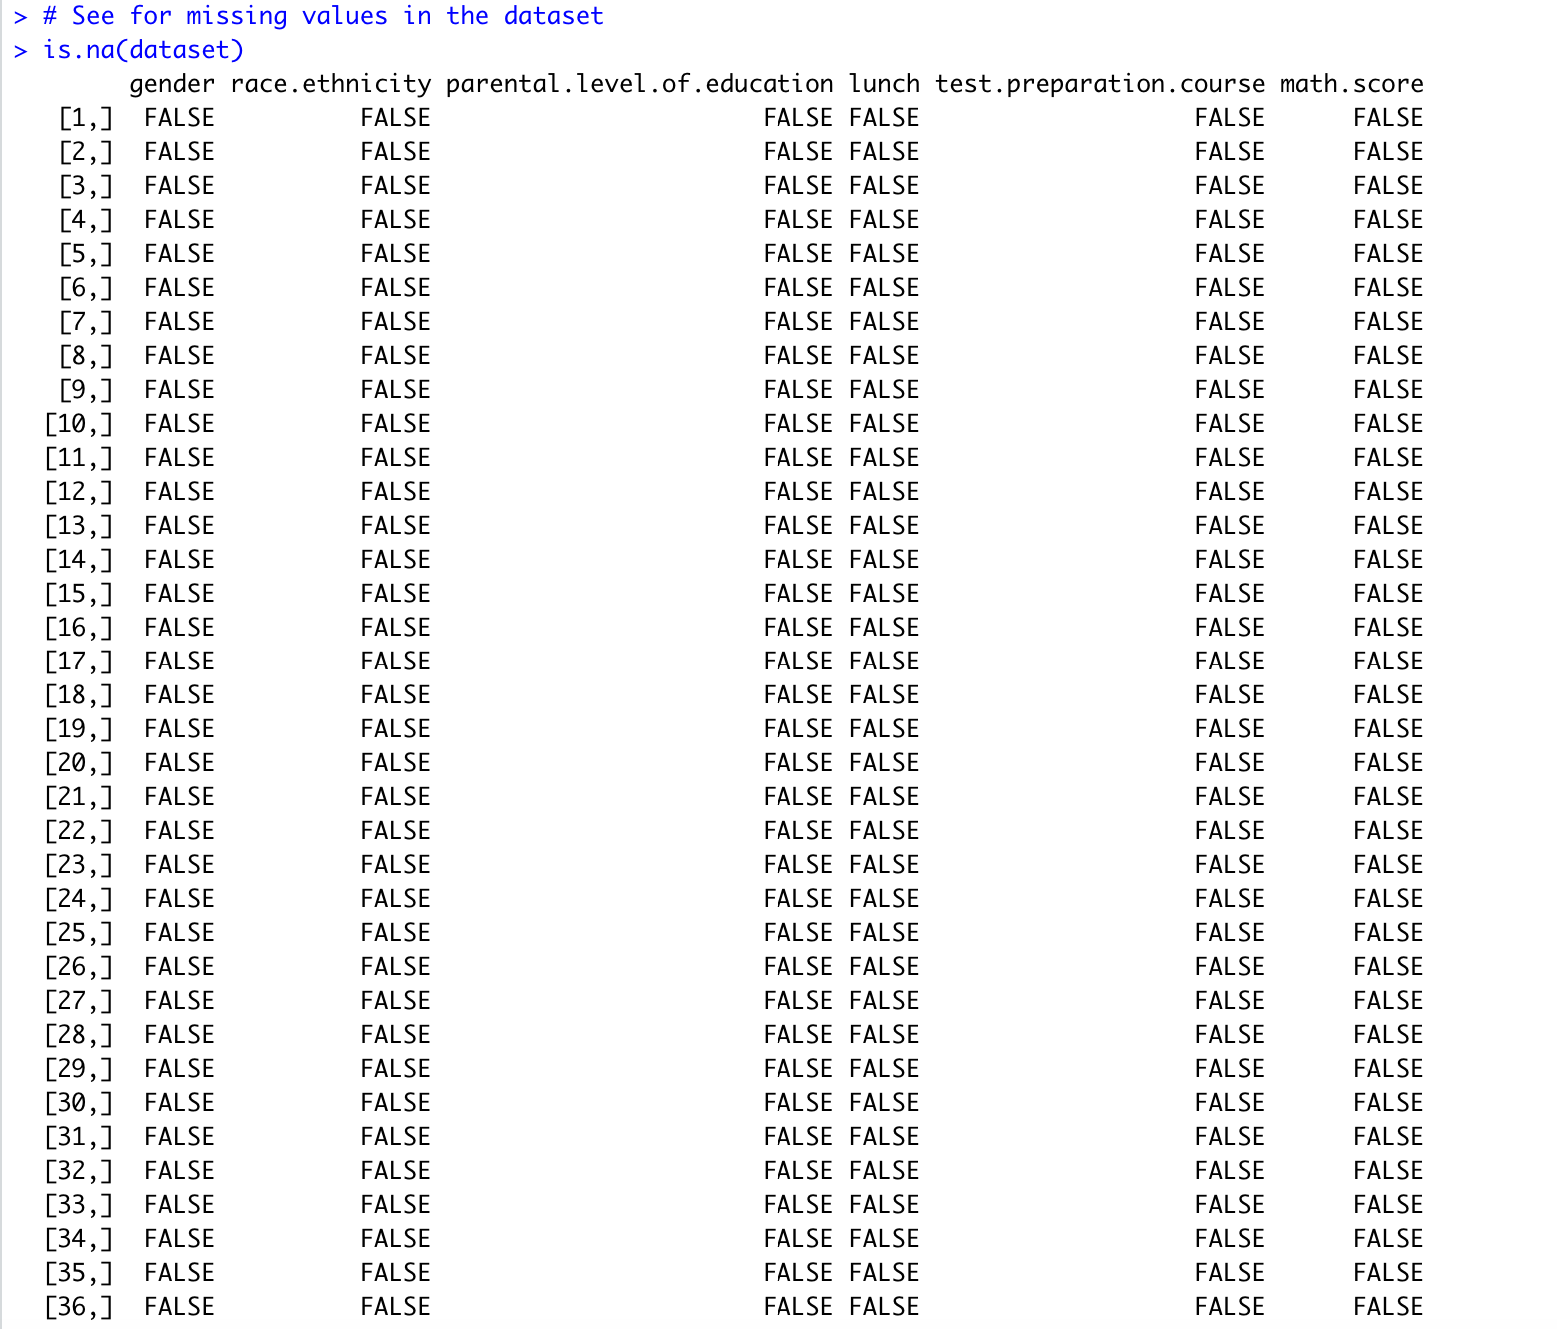
Data preparing and preprocessing
Import the dataset into R
See if there are missing values in the dataset

Slide 4
Analysis of categorical variable
Choose the categorical variable of race. ethnicity to analyze
The table below shows the frequency of this categorical variable
Race. ethnicity | Frequency
Group A | 89
Group B | 190
Group C | 319
Group D | 262
Group E | 140

Slide 5
Graphical representations of categorical data
From those different kinds of graph representation, the group C is the top main group for race and ethnicity

Slide 6
Analysis of numerical variable
Choose the student’s math score as a numerical variable to analyze
The mean of math score variable is 66.09
The median of math score variable is 66
The variance and the standard deviation of math score are 229.9 and 15.16 respectively.

Slide 7
Graphical Representation of numerical variable
As these graphs shown, student’s maximum math score is 100 and minimum math score is 0
In addition, most of student’s math score are around from 60 to 70

Slide 8
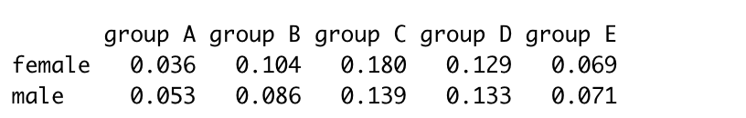
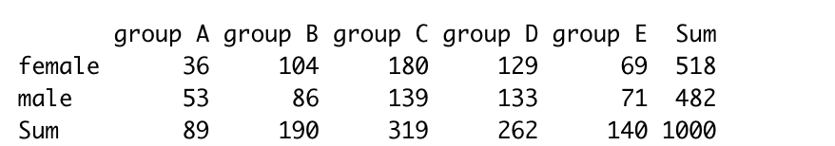
Analysis of one set of two variables
The two variables of gender and race are shown as two-way table by adding marginal distribution
The proportions for the gender and race dataset along the columns are shown below

Slide 9
Graphical summarization of two-way tables
From these plots, there are most female and male in the race of group C
Conversely, among the group A of race, male and female are the least amount

Slide 10
Analysis of numerical data & examine distribution
Pick the student’s reading score as another numerical data and examine its distribution
From the distribution of the graph below, the distribution is left skewed

Slide 11
Various random samples of data & applicability of Central Limit Theorem
Draw 1000 samples of the data of size 10, size 20, size 30, size 40 to show the histogram of densities sample means
Compute the means and standard deviations of the above four distribution

Slide 12
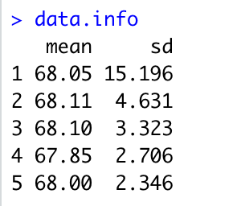

Slide 13
As the sample size increase, the spread of the distribution becomes narrower and approach to the shape of normal distribution
In the meantime, the mean of sample means gets closer to the mean of the data and the standard deviation will decrease as the sample size increases

Slide 14
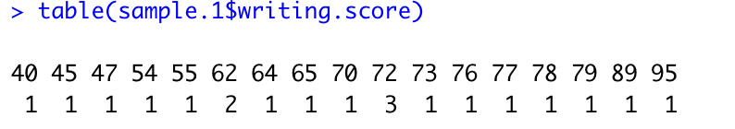
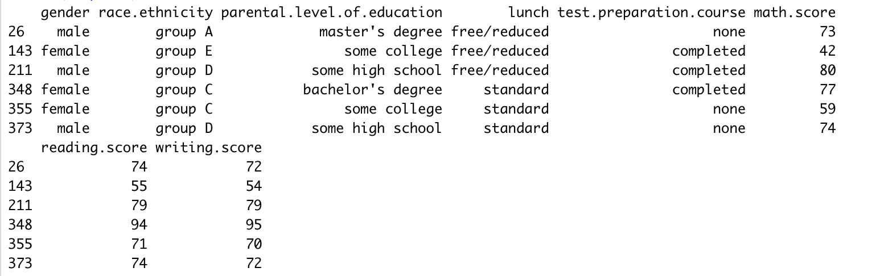
Various sampling methods
Sampling method 1 — Simple Random Sampling
Use sample size of 20 and show the frequencies for each student’s writing scores in the dataset

Slide 15
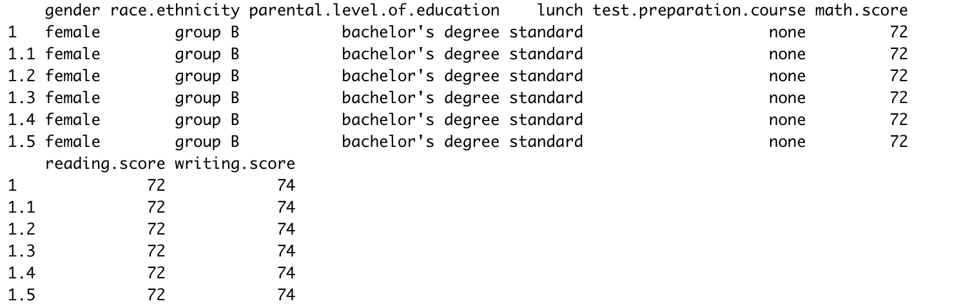
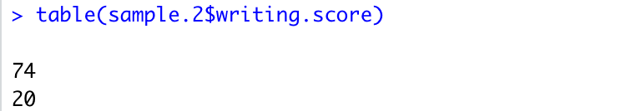
Sampling method 2 — Systematic Sampling
Use sample size of 20 and show the frequencies for each student’s writing scores in the dataset

Slide 16
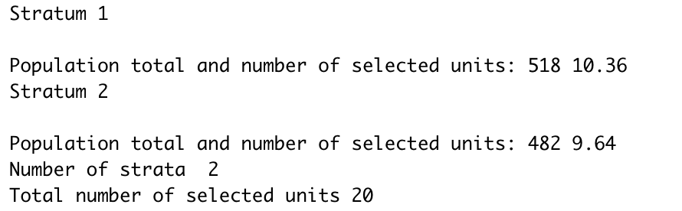
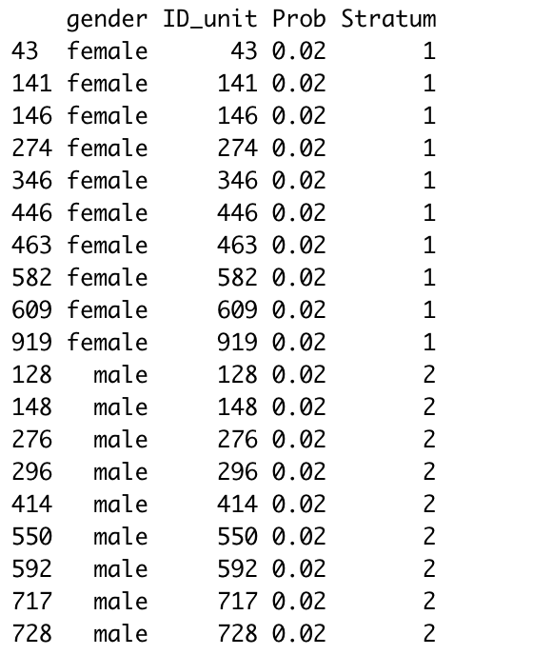
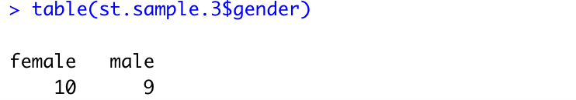
Sampling method 3 — Stratified Sampling
Use sample size of 20 and show the frequencies for gender variable in the dataset

Slide 17
Conclusion
If samples are used instead of whole dataset, as the sample size grows up, the mean of the sample mean distribution reaches the mean of the parent data and the standard deviation of the sample mean distribution will decrease
In addition, with sampling, it can save our time consuming on our large dataset, a sample is used by the suitable sampling methods or strategy can also yield valid and reliable information

Slide 18
Thank you!

